Slide 1
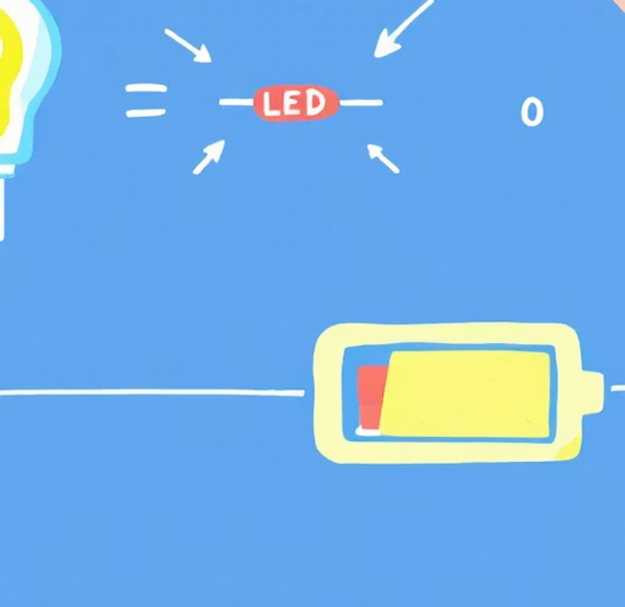
Study of Light-Emitting Diodes (LEDs)
Presented by
Jannatul Khould Neju.

Slide 2
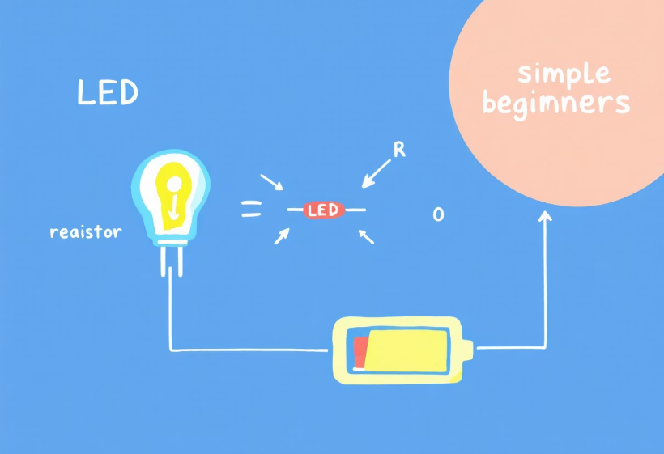
Understanding LED Objectives
Our study of LEDs aims to achieve key objectives. First, we seek to understand the working principle of LEDs.
Next, we plan to analyze their electrical characteristics. Finally, we intend to explore LED applications in lighting systems.

Slide 3

LED Theory and Basics
Semiconductor Devices
Electroluminescence
LEDs are semiconductor devices that emit light.
Light is emitted through electroluminescence, a fundamental process.
Bandgap Dependency
The color of emitted light depends on the semiconductor bandgap.

Slide 4
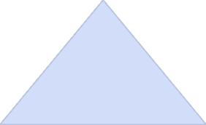

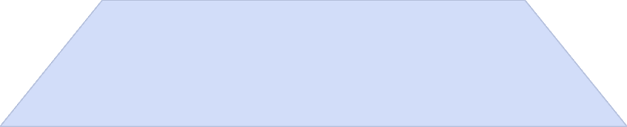
LED Working Principle
Photon Emission
1
Energy as photons.
Electron Recombination
2
Holes release energy.
Threshold Voltage
3
Light emission starts.

Slide 5
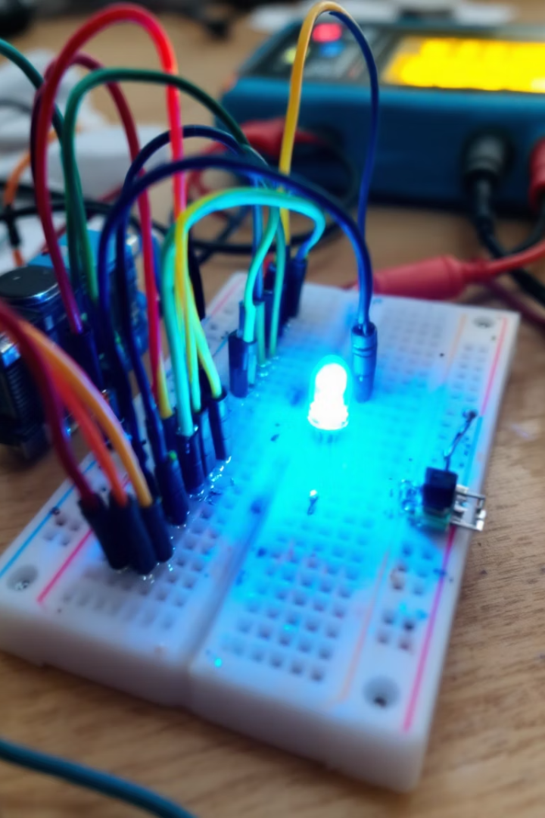



Experimental Setup Components
Red LED
Power Supply
470 Ohm Resistor
Our experimental setup includes essential components. A red LED is used as the light source. A power supply (3V–12V DC) provides the necessary voltage. Additionally, a 470 Ohm resistor limits the current.

Slide 6
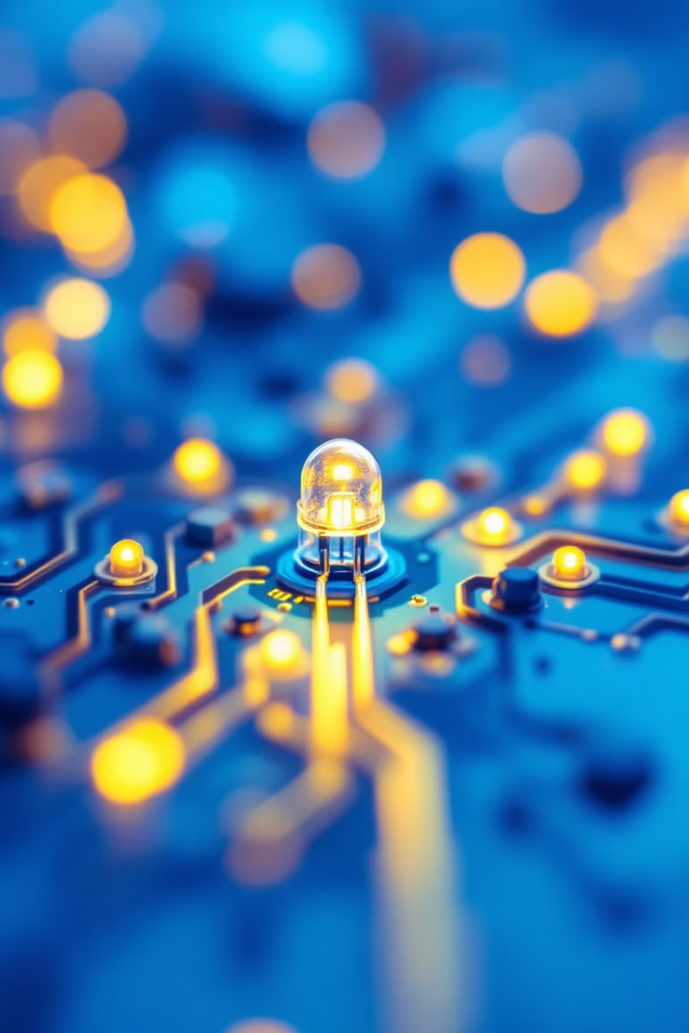
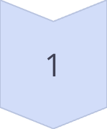
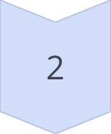
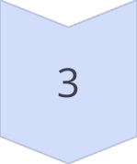
Forward Bias Testing Procedure
Series Connection
Connect LED and resistor.
Voltage Application
Apply different voltages.
Brightness Observation
Observe changes in brightness.

Slide 7
V-I Characteristics and Reverse Bias
V-I Characteristics
Reverse Bias Test
Measure current at increasing voltages.
Reverse LED connection.
Identify the threshold voltage.
Observe current flow (negligible).

Slide 8

Observations and Data
Measurement Name
Value
LED Type
Red
Threshold Voltage
2V
Forward Current
15mA
Reverse Leakage
Negligible

Slide 9
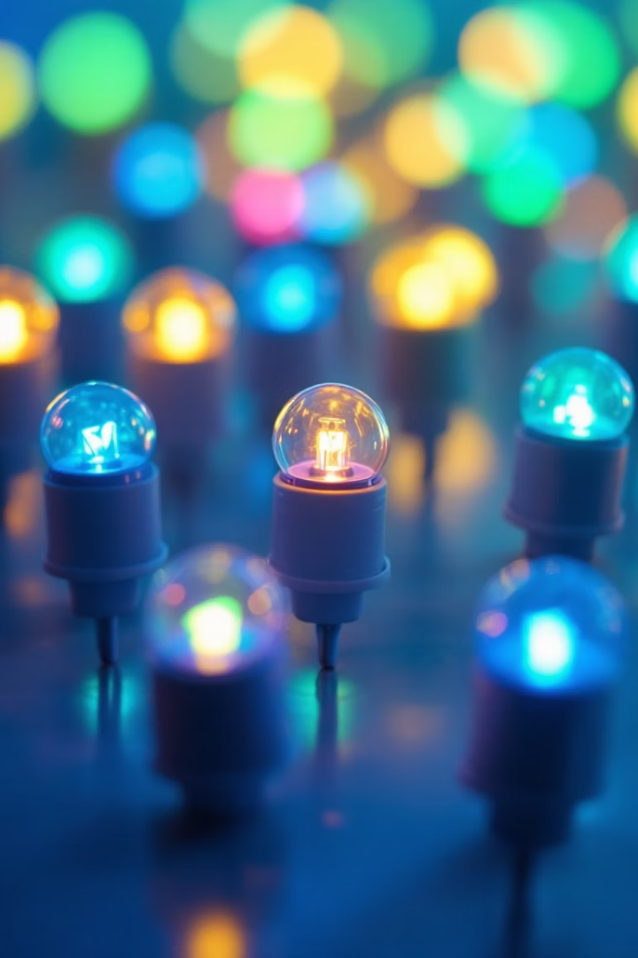
Key Conclusions
Voltage Threshold
Brightness & Current
LEDs work above threshold.
Brightness increases with current.
Reverse Bias
Minimal current in reverse.

Slide 10
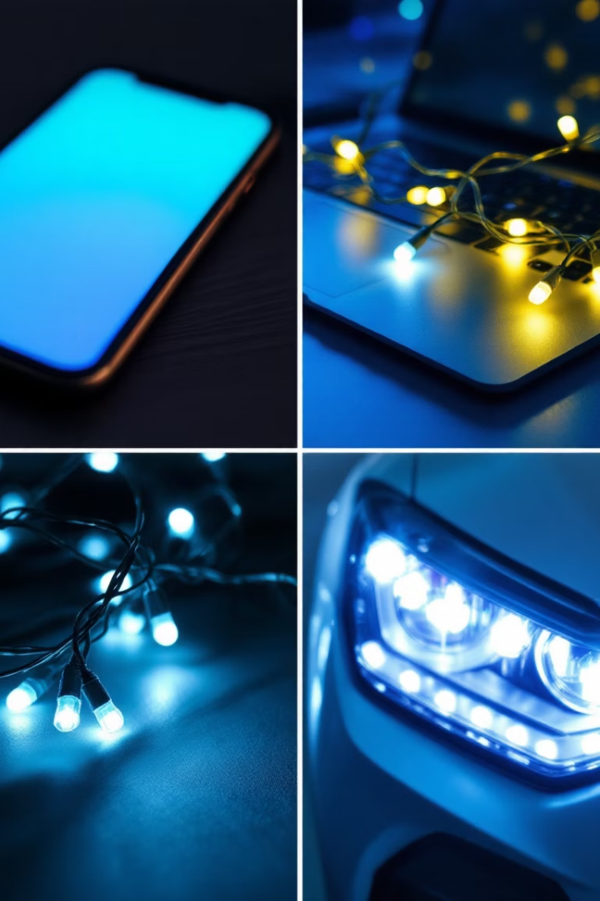
Applications and Final Thoughts
Indicator Lights
LEDs are widely used as indicator lights in various devices.
Display Panels
They are essential components in display panels and screens.
Lighting Systems
LEDs are increasingly common in general lighting systems.

Slide 11
The End
Thank you

